Slide 1
Object-Oriented Programming
Programming Project #1
郭建志

Slide 2
Background
Local area network within a data center
Routing efficiency is critical to system performance and quality of service
destination
source

Slide 3
The Routing Problem
Requests
(src, dest; demand):
(A, F; 1)
(A, F; 2)
(B, E; 1)
(B, E; 3)
(B, E; 4)
(B, C; 1)
(B, D; 3)
(A, B; 4)
(A, C; 2)
(D, F; 4)
(E, F; 5)
(B, C; 6)
(B, D; 2)
(B, D; 1)
(B, D; 2)
(C, E; 3)
(C, E; 1)
Consider a scenario, where each request has a different size:
B
4
D
1
1
A
2
2
F
1
1
C
E
2

Slide 4
One Routing Solution
Requests
(src, dest; demand):
(A, F; 1)
(A, F; 2)
(B, E; 1)
(B, E; 3)
(B, E; 4)
(B, C; 1)
(B, D; 3)
(A, B; 4)
(A, C; 2)
(D, F; 4)
(E, F; 5)
(B, C; 6)
(B, D; 2)
(B, D; 1)
(B, D; 2)
(C, E; 3)
(C, E; 1)
B
4
D
1
1
A
2 (1)
2
F
1 (1)
1 (1)
C
E
2 (2)

Slide 5
The Online Routing Problem
Requests
(src, dest; demand):
(A, F; 1)
(A, F; 2)
(B, E; 1)
(B, E; 3)
(B, E; 4)
(B, C; 1)
(B, D; 3)
(A, B; 4)
(A, C; 2)
(D, F; 4)
(E, F; 5)
(B, C; 6)
(B, D; 2)
(B, D; 1)
(B, D; 2)
(C, E; 3)
(C, E; 1)
The requests are arrived in an online fashion.
B
4
D
1
1
A
2
2
F
1
1
C
E
2

Slide 6
Programming Project #1: Accept or reject a flow
Input file: 5 10 0 0 1 14 1 0 2 12 2 0 3 9 ...
0 0 1 8
1 2 1 6
…
Input:
Numbers of nodes and undirected links
Undirected links with non-negative link capacities
Requested flows with their sources, destinations, and sizes
Procedure:
Accept or reject the flow one by one
If accepted, then assign a path
Output:
Number of accepted flows
Total throughput
The assigned paths of each accepted flow
The grade is proportional to the total throughput
Output file:
15 124 0 0 1
1 2 0 1
…

Slide 7
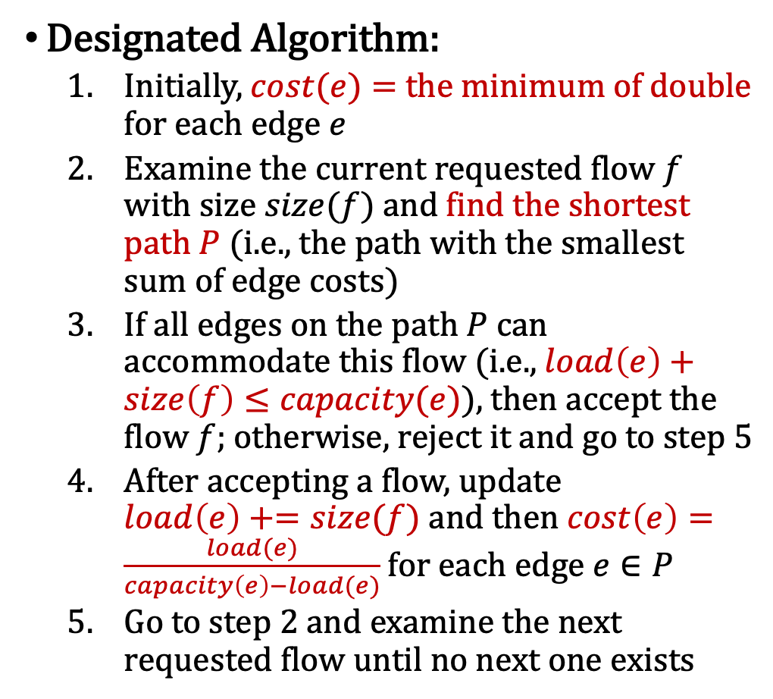
Programming Project #1: Accept or reject a flow
Input file: 5 10 0 0 1 14 1 0 2 12 2 0 3 9 ...
0 0 1 8
1 2 1 6
…
Designated Algorithm:
Initially, $cost(e)=$ the minimum of double for each edge $e$
Examine the current requested flow $f$ with size $size(f)$ and find the shortest path $P$ (i.e., the path with the smallest sum of edge costs)
If all edges on the path $P$ can accommodate this flow (i.e., $load\left(e\right)+size\left(f\right)≤capacity(e)$), then accept the flow $f$; otherwise, reject it and go to step 5
After accepting a flow, update $load\left(e\right)+=size(f)$ and then $cost\left(e\right)=\frac{load(e)}{capacity\left(e\right)−load(e)}$ for each edge $e∈P$
Go to step 2 and examine the next requested flow until no next one exists
Output file:
15 124 0 0 1
1 2 0 1
…

Slide 8
0 |  | 1 |  | 2 |  | 3 |  | 4 |  | 5
-2 | 0…. | -1 | 0.... | -1 | 0. | -1 | 0. | -1 | 0. | -1 | 0.
-2 | 0. | 0 | 3 | 0 | 15 | 1 | 3+1 | 1 | 3+10 | 2 | 15+12
-2 | 0. | 0 | 3 | 0 | 15 | 1 | 4 | 1 | 13 | 4 | 13+4
0 | 1 | 2 | 3 | 4 | 5

Slide 9
Discussion
Why does the algorithm work?
It chooses the path that avoids the link with a heavy load
What can be added to improve the performance?
Discussion & bonus

Slide 10
Discussion
Why does the algorithm work?
It chooses the path that avoids the link with a heavy load
What can be added to improve the performance?
Discussion & bonus
Design a new edge cost formula?
Add an acceptance condition?

Slide 11
Further Reading
Section 9.1 in “The Design of Competitive Online Algorithm via a Primal-Dual Approach”, Foundations and Trends in Theoretical Computer Science, 2009.
Dynamic Routing for Network Throughput Maximization in Software-Defined Networks, in INFOCOM 2016
…
有興趣可以找我要paper
我猜沒有人XD

Slide 12
Input Sample: request.txt
Format:
#nodes #undirectedLinks
#linkID #firstNode #secondNode #linkCapacity
…
#requestFlows
#flowID #sourceID #destinationID #flowSize
…
下次揭曉，先自己設計input

Slide 13
Output Sample: result.txt
Format:
#acceptedFlows totalThroughput
#flowID #firstNode #secondNode … #lastNode
下次揭曉，用自己設計input產生答案

Slide 14
Input Sample: request.txt
Format:
#nodes #undirectedLinks
#linkID #firstNode #secondNode #linkCapacity
…
#requestFlows
#flowID #sourceID #destinationID #flowSize
…
10
0 2 4 4
1 2 3 5
2 4 5 6
3 4 1 4
4 0 3 4
5 4 2 7
6 5 0 4
7 3 0 5
8 2 1 4
9 5 2 4
Format:
6 8
0 0 1 11
1 0 2 11
2 0 5 11
3 1 2 9
4 2 3 10
5 3 4 10
6 3 5 9
7 4 5 9
0
11
5
11
9
1
11
9
4
9
10
2
3
10

Slide 15
Output Sample: result.txt
Format:
#acceptedFlows totalThroughput
#flowID #firstNode #secondNode … #lastNode
Format:
6 27
0 2 3 4
1 2 0 5 3
2 4 5
3 4 3 2 1
4 0 5 3
8 2 1
10
0 2 4 4
1 2 3 5
2 4 5 6
3 4 1 4
4 0 3 4
5 4 2 7
6 5 0 4
7 3 0 5
8 2 1 4
9 5 2 4

Slide 16
Note
Deadline: 3/26 Tue
E-course
C++ Source code
Show a good programming style

